Slide 1

DriverPass System Analysis
Prepared by: Malakai Magharing
Notes:
[No speaker notes required for this slide.]

Slide 2

System Requirements
- Cloud-based web application for online exams and scheduling.
- Role-based access for students, staff, and administrators.
- Secure data storage and payment integration.
- Accessible on desktop and mobile devices.
Notes:
The DriverPass system will operate as a cloud-based platform, allowing both students and staff to access it from any device. Each user type—student, secretary, or administrator—will have permissions based on their role. The system securely stores all user and payment information, and the interface works smoothly on both desktop and mobile devices.

Slide 3
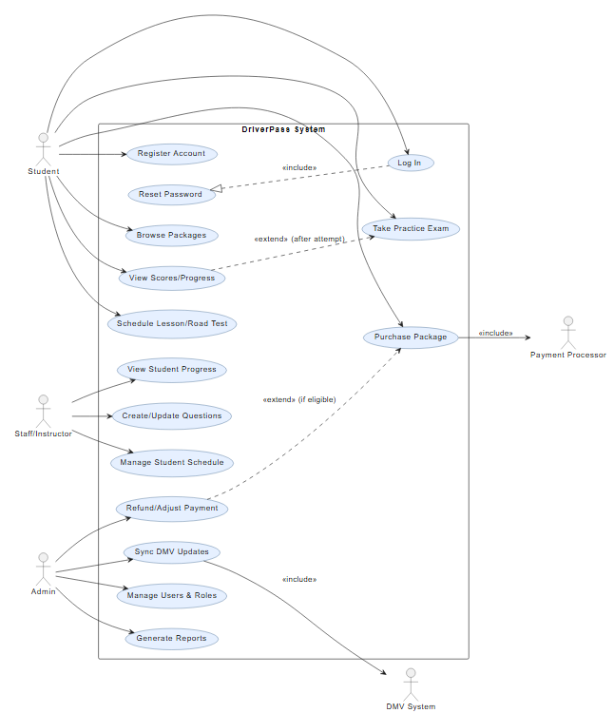
Use Case Diagram
[Insert your use case diagram here.]
Notes:
This diagram shows how each user interacts with the system. Students can register, schedule driving lessons, and take online practice tests. Secretaries can help manage bookings and student profiles. Administrators and IT officers oversee account access and system management, while the DMV system automatically updates any new test rules or questions. Together, these connections ensure DriverPass functions efficiently for everyone involved.

Slide 4
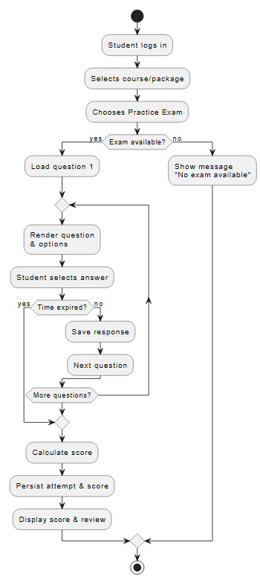
Activity Diagram
Notes:
This activity diagram shows the steps a student takes to schedule a driving lesson. After logging in, the student selects a lesson time from available slots. The system checks availability to ensure there are no conflicts. Once confirmed, the lesson details are saved to the database, and a confirmation email is sent automatically. This design ensures accuracy, efficiency, and a smooth experience for both students and instructors.

Slide 5
Security
- Role-based permissions (student, staff, admin)
- Encrypted logins and password resets
- PCI-compliant payment system
- Regular activity tracking and reporting
Notes:
Security is one of the most important features of the DriverPass system. Each user role has specific permissions, so no one can access data they shouldn’t. All passwords are encrypted, and password resets are handled securely. Payments follow PCI standards for data protection, and the system logs all activities to identify unauthorized access or changes.

Slide 6
System Limitations
Offline access limited to downloaded reports
DMV updates depend on external systems
Only developers can modify modules
Notes:
While the DriverPass system is designed to be robust, there are some limitations. Most features require an internet connection, though reports can be downloaded for offline use. The DMV data feed determines how often new updates appear. Finally, system modifications such as adding or removing modules require a developer’s involvement to maintain integrity and prevent errors.

